Slide 1
Analysis of Algorithm Efficiency
Mina Gabriel

Slide 2

Introduction
Big-O notation is used extensively to estimate the number of operations an algorithm uses as its input grows. With the help of this notation, we can determine whether it is practical to use a particular algorithm to solve a problem as the size of the input increases.
Furthermore, using big-O notation, we can compare two algorithms to determine which is more efficient as the size of the input grows.
For instance, if we have two algorithms for solving a problem, one using $100n^{2}+17n+4$ operations and the other using $n^{3}$ operations, big-O notation can help us see that the first algorithm uses far fewer operations when n is large, even though it uses more operations for small values of n, such as n = 10.

Slide 3
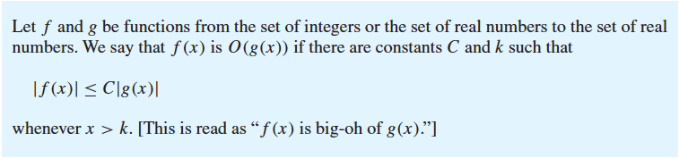
Big-O Notation
The growth of functions is often described using a special notation.

Slide 4
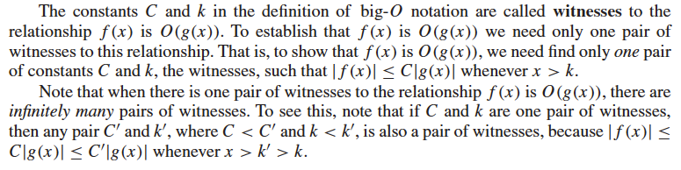

Slide 5
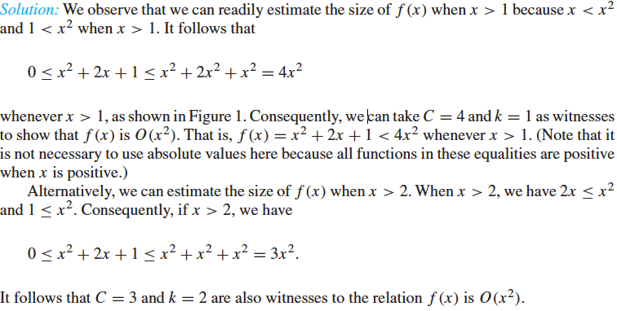
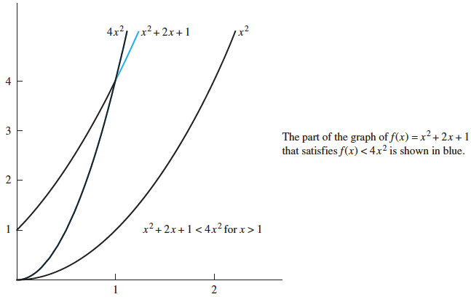
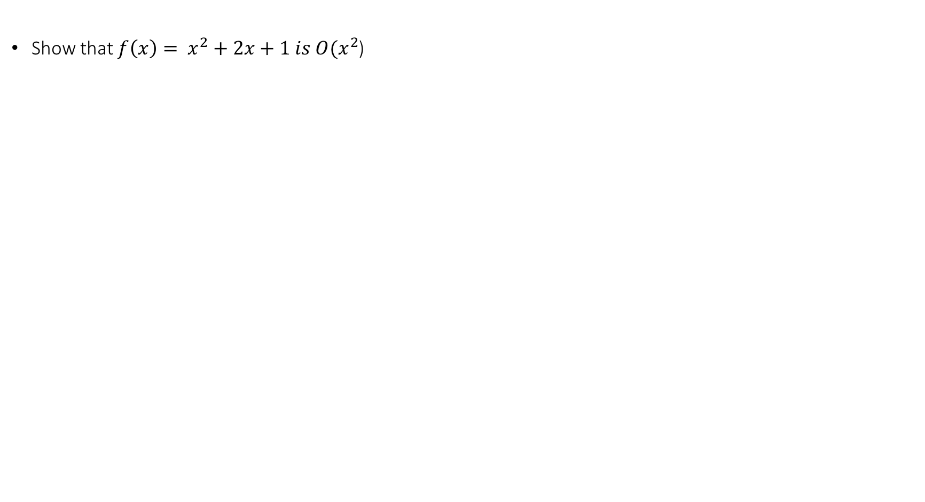
Example 1
Show that $f\left(x\right)= x^{2}+2x+1 is O(x^{2}$)

Slide 6
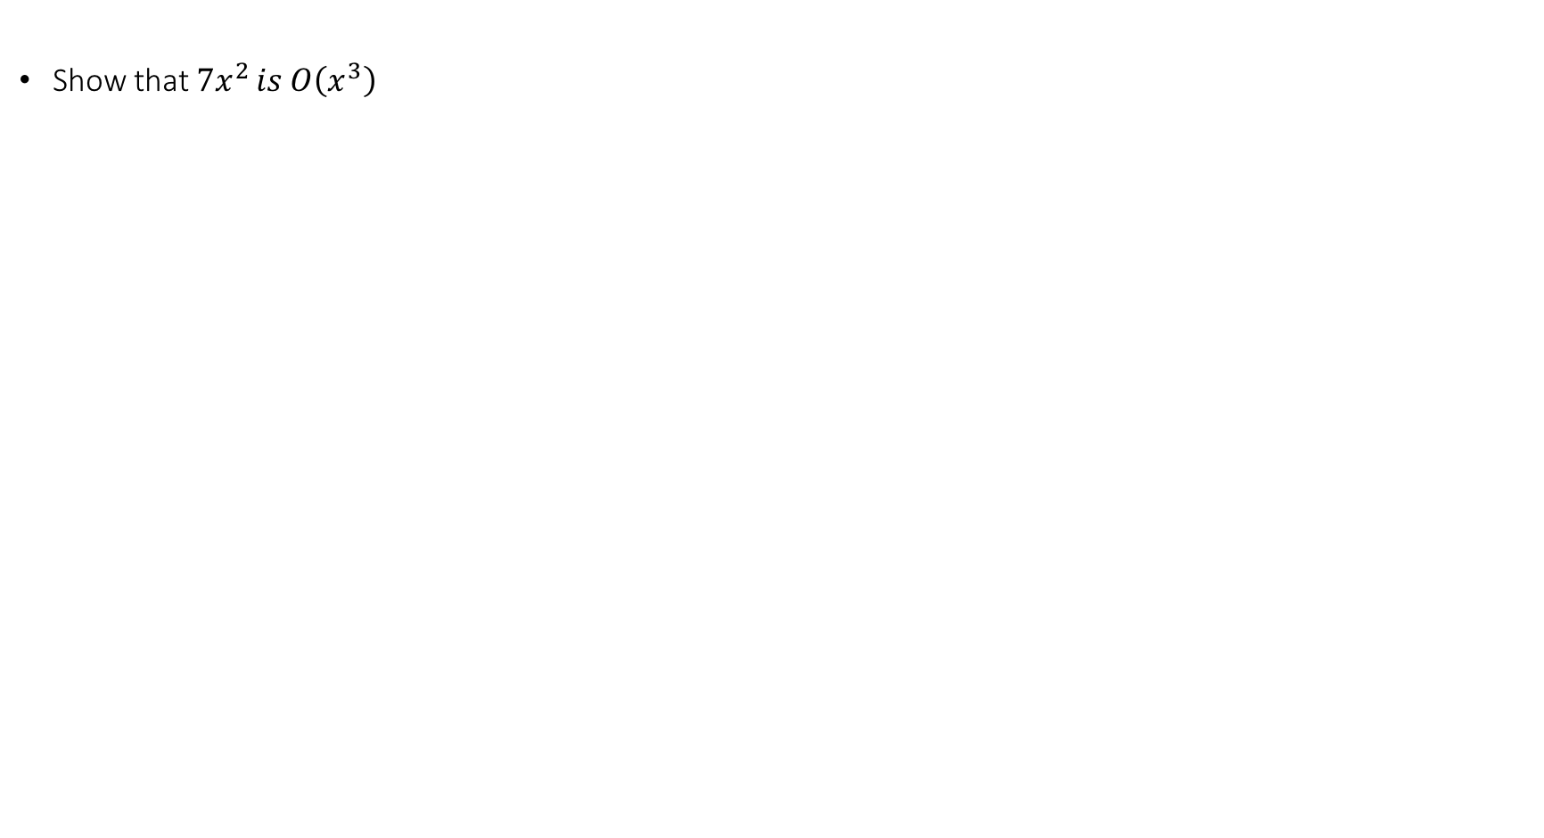
Exercise 1
Show that $7x^{2 }is O\left(x^{3}\right)$

Slide 7
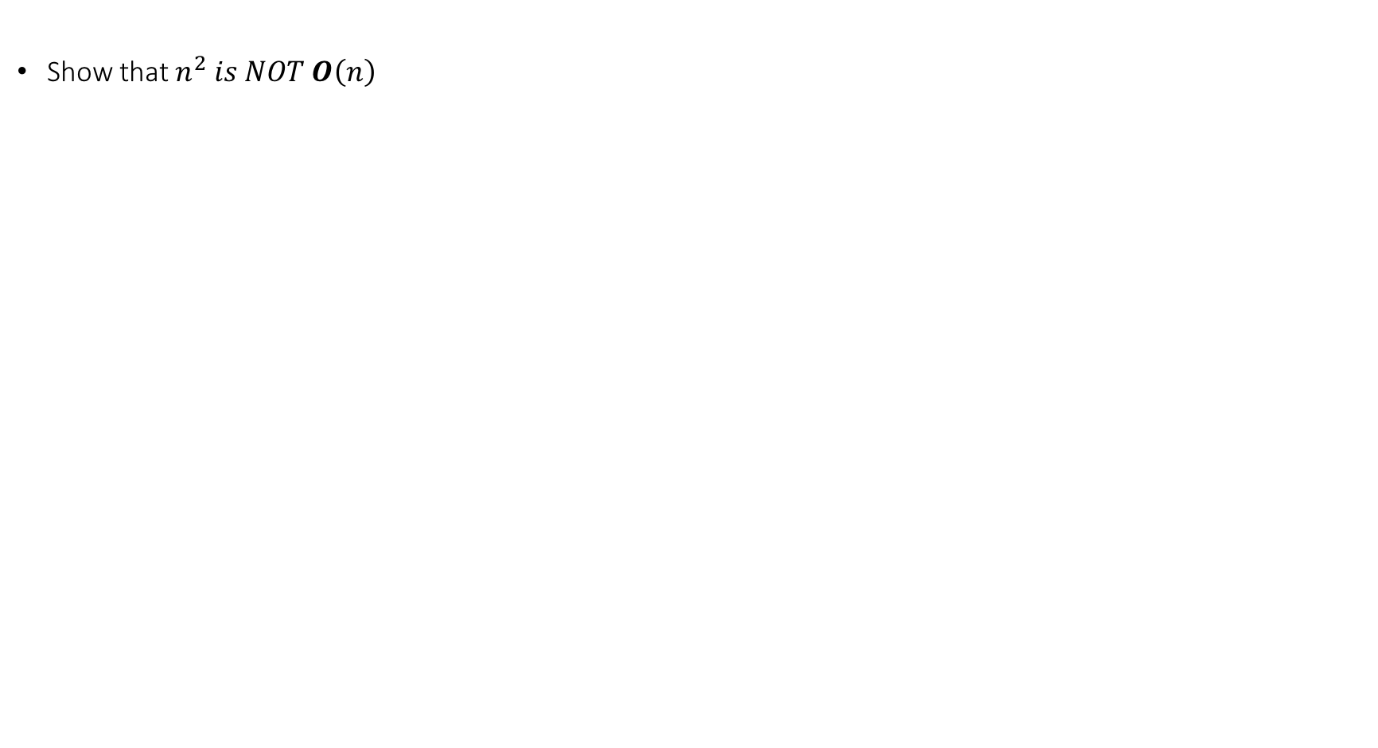
Exercise 2
Show that $n^{2} is NOT Ο\left(n\right)$

Slide 8

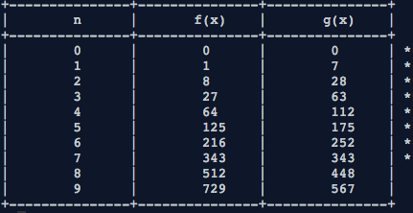
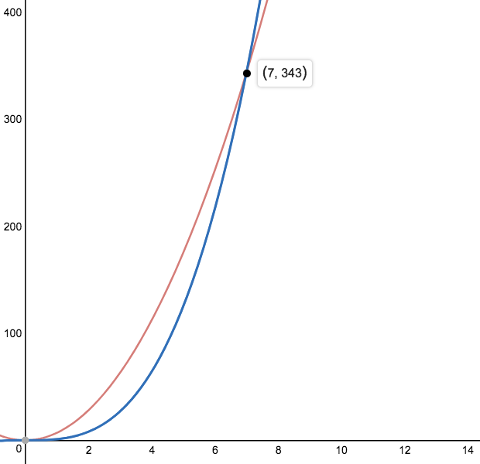
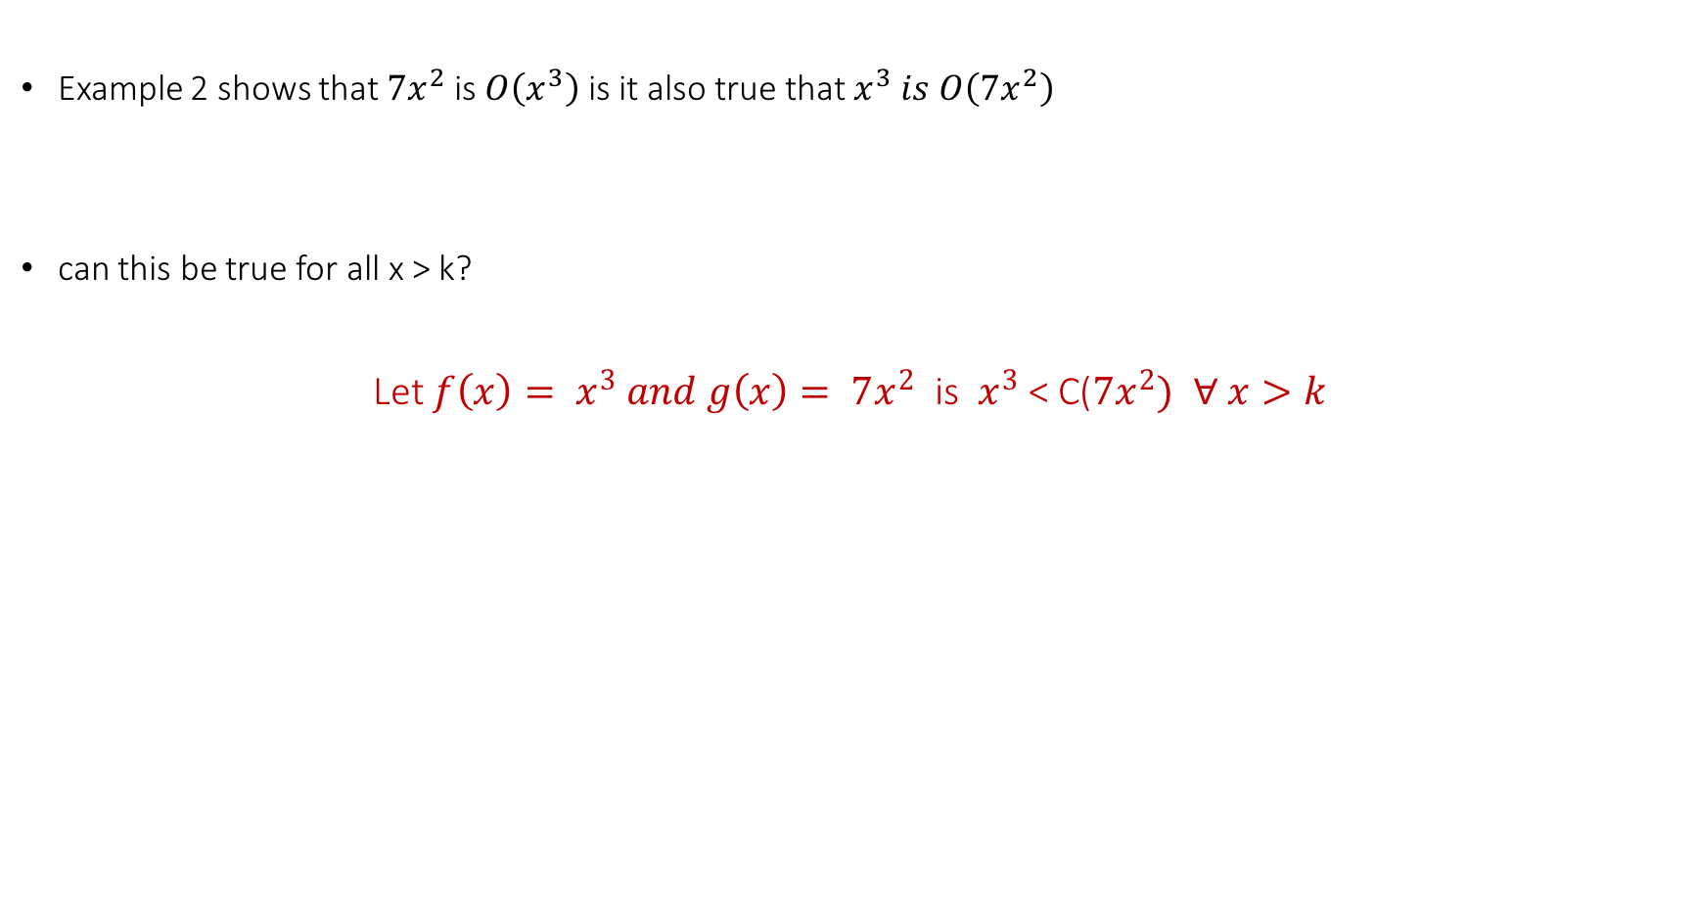
Example 4
Example 2 shows that $7x^{2}$ is $O\left(x^{3}\right)$ is it also true that $x^{3} is O\left(7x^{2}\right)$
can this be true for all x > k?
Let $f\left(x\right)= x^{3} and g\left(x\right)= 7x^{2}$ is $x^{3}$ < C($7x^{2})$ $∀ x>k$
https://repl.it/LAkN/7

Slide 9



Big-O Estimates for Some Important Functions
Polynomials can often be used to estimate the growth of functions. Instead of analyzing the growth of polynomials each time they occur, we would like a result that can always be used to estimate the growth of a polynomial. Theorem 1 does this. It shows that the leading term of a polynomial dominates its growth by asserting that a polynomial of degree n or less is $O\left(x^{n}\right)$
Theorem 1

Slide 10
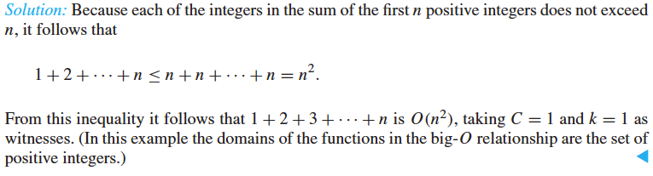

Example 5
How can big-O notation be used to estimate the sum of the first $n$ positive integers?

Slide 11
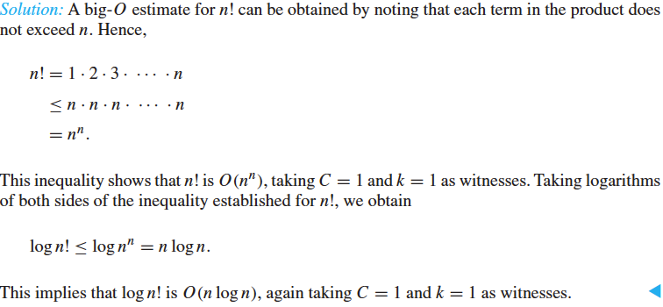

Example 6
Give big-O estimates for the factorial function and the logarithm of the factorial function, where the factorial function $f\left(n\right)=n!$ Is defined by
$$n!=1 . 2 . 3 … . n$$
Note that the function $n!$grows rapidly. For instance,
$$20! = 2,432,902,008,176,640,000.$$

Slide 12
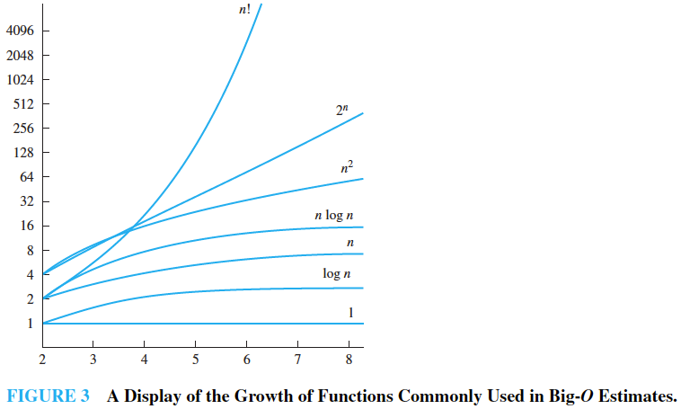

As mentioned before, big-O notation is used to estimate the number of operations needed to solve a problem using a specified procedure or algorithm. The functions used in these estimates often include the following:
$$1 , \log{n , n , n\log{n, { n}^{2}}, { 2}^{n}, n!}$$
Using calculus it can be shown that each function in the list is smaller than the succeeding function, in the sense that the ratio of a function and the succeeding function tends to zero as n grows without bound. Figure 3 displays the graphs of these functions, using a scale for the values of the functions that doubles for each successive marking on the graph. That is, the vertical scale in this graph is logarithmic.

Slide 13
The Growth of Combinations of Functions
Many algorithms are made up of two or more separate subprocedures. The number of steps used by a computer to solve a problem with input of a specified size using such an algorithm is the sum of the number of steps used by these subprocedures. To give a big-O estimate for the number of steps needed, it is necessary to find big-O estimates for the number of steps used by each subprocedure and then combine these estimates.

Slide 14
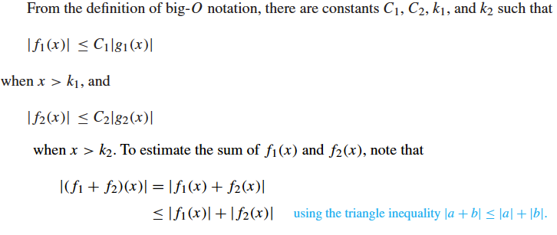

Big-O estimates of combinations of functions can be provided if care is taken when different big-O estimates are combined. In particular, it is often necessary to estimate the growth of the sum and the product of two functions. What can be said if big-O estimates for each of two functions are known? To see what sort of estimates hold for the sum and the product of two functions, suppose that $f_{1}\left(x\right)is O\left(g_{1}\left(x\right)\right)and{ f}_{2}\left(x\right)is O\left(g_{2}\left(x\right)\right)$

Slide 15
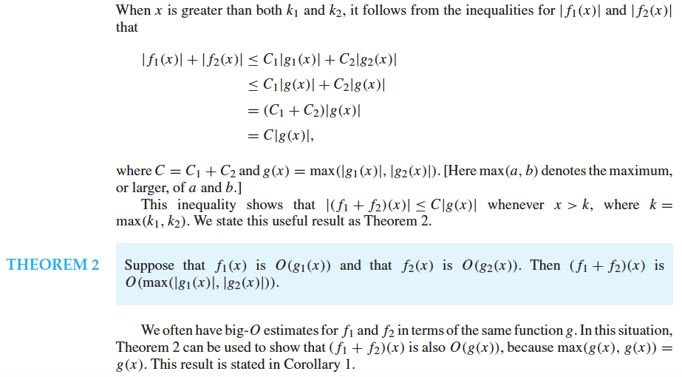

Slide 16
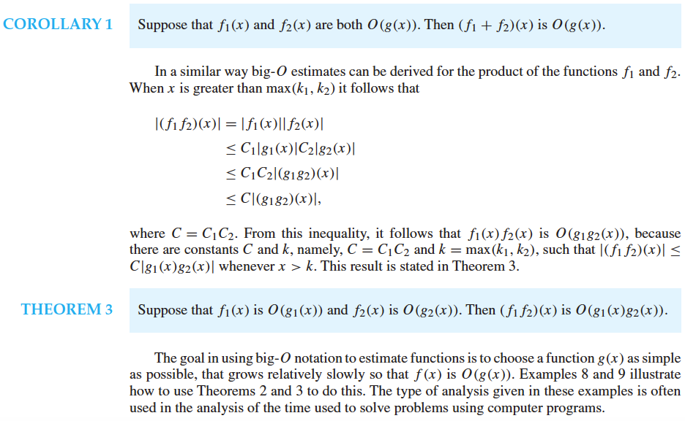

Slide 17
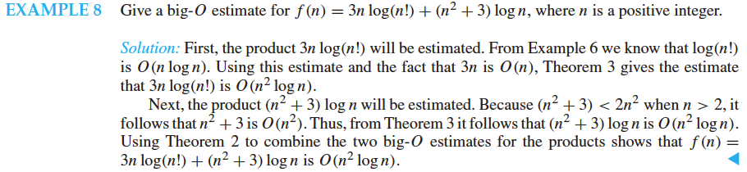

Slide 18
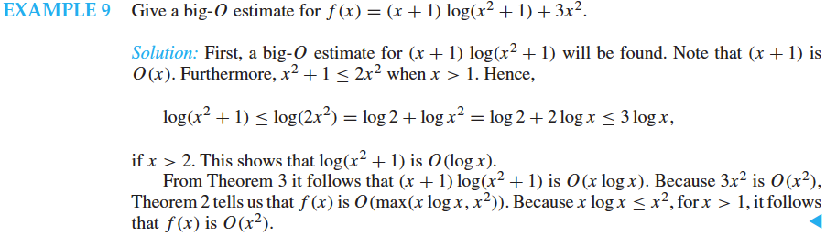

Slide 19

Big-Omega and Big-Theta Notation
Big-O notation is used extensively to describe the growth of functions, but it has limitations. In particular, when $f(x),$is $O(g(x)),$we have an upper bound, in terms of $g(x),$for the size of $f(x),$for large values of $x$.
However, big-O notation does not provide a lower bound for the size of $f(x),$for large $x$. For this, we use big-Omega (big-$Ω$) notation.
When we want to give both an upper and a lower bound on the size of a function $f(x),$relative to a reference function $g(x),$we use big-Theta (big-$Θ$) notation.

Slide 20
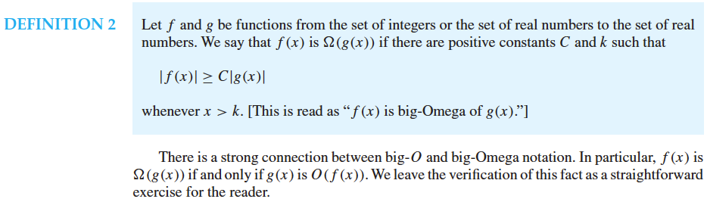

Slide 21
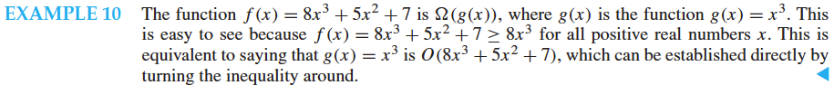

Slide 22
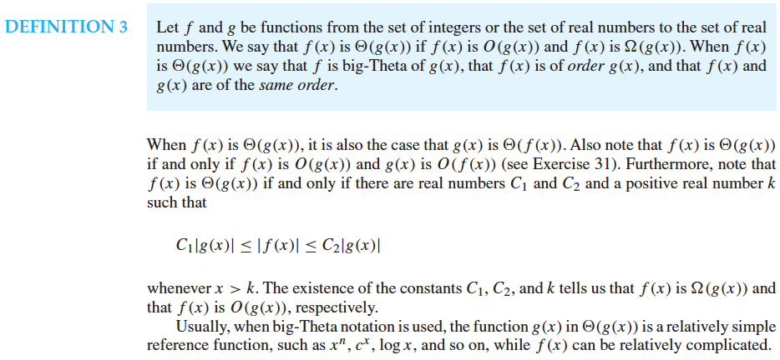

Slide 23
